Slide 1


Slide 2
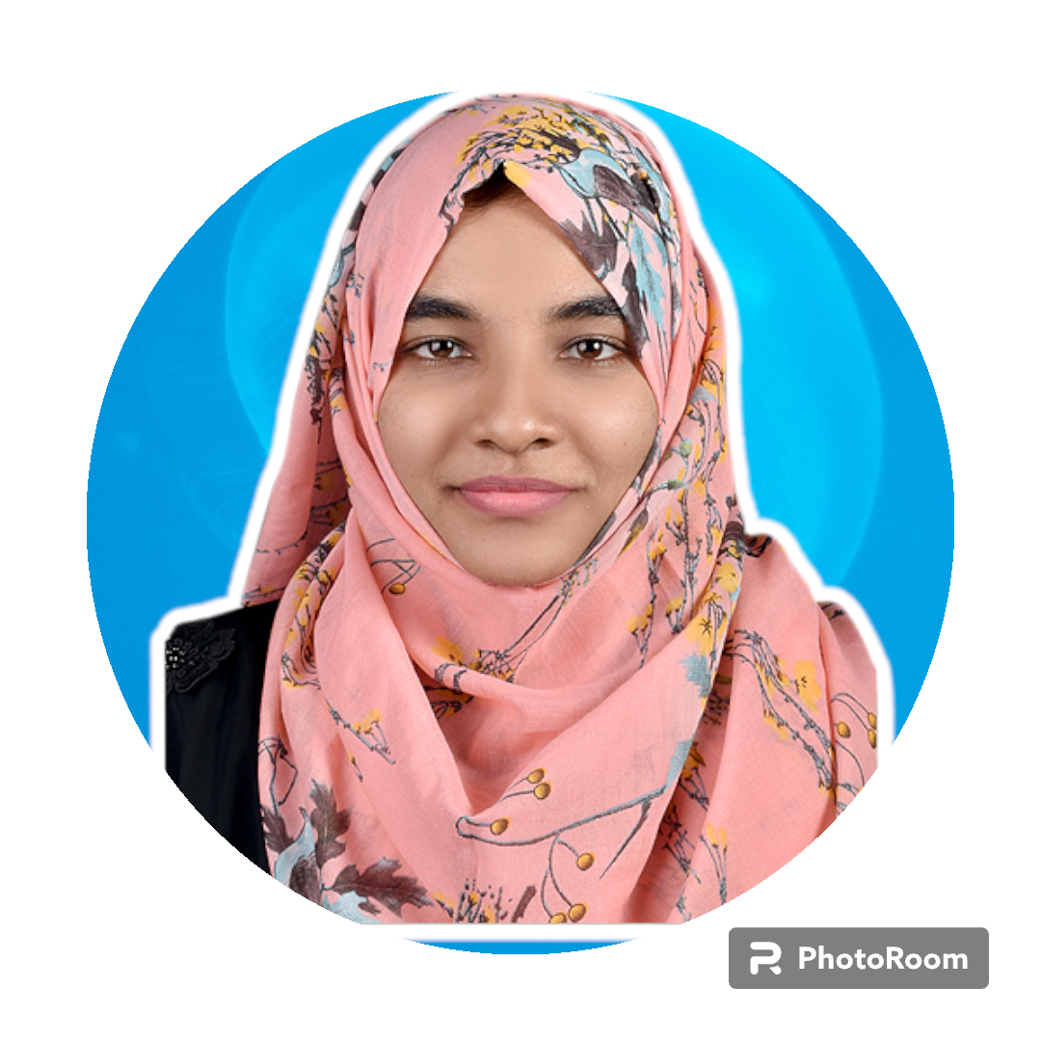
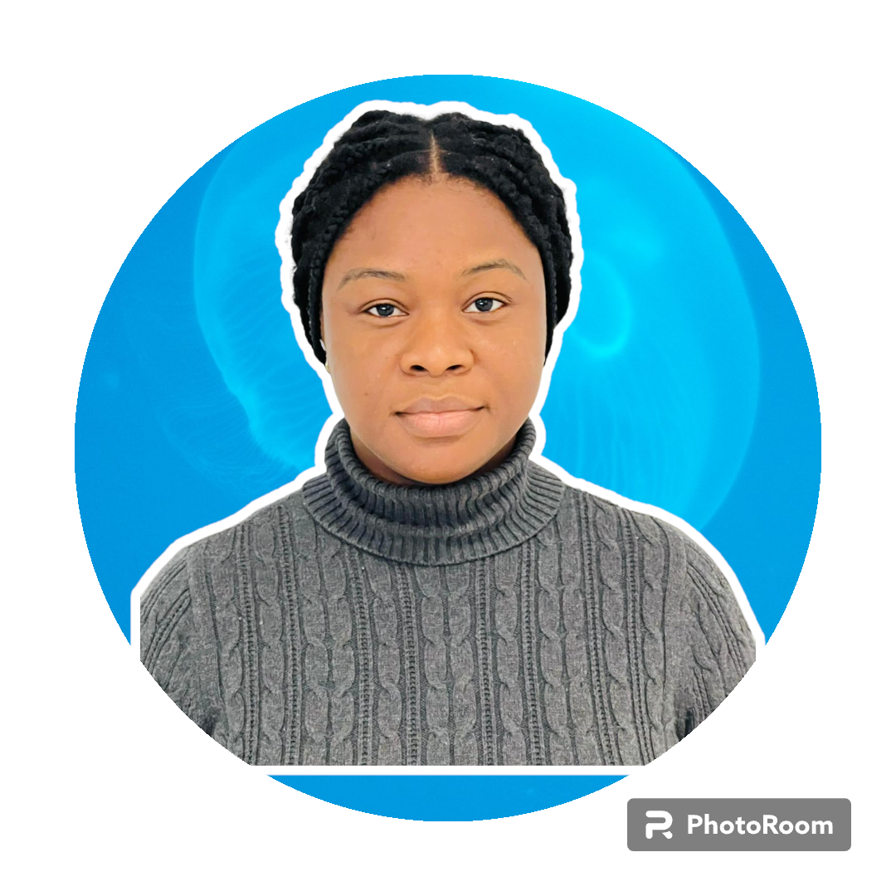
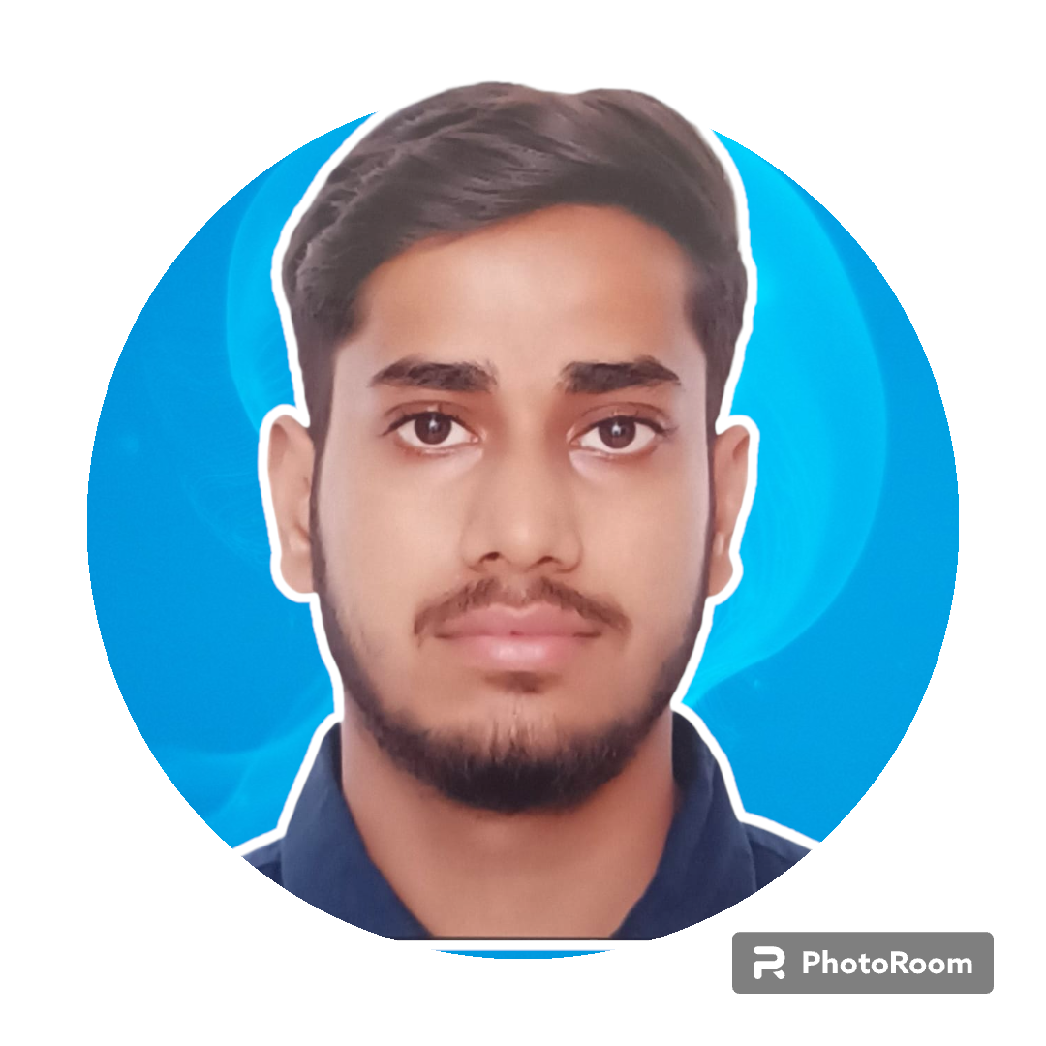
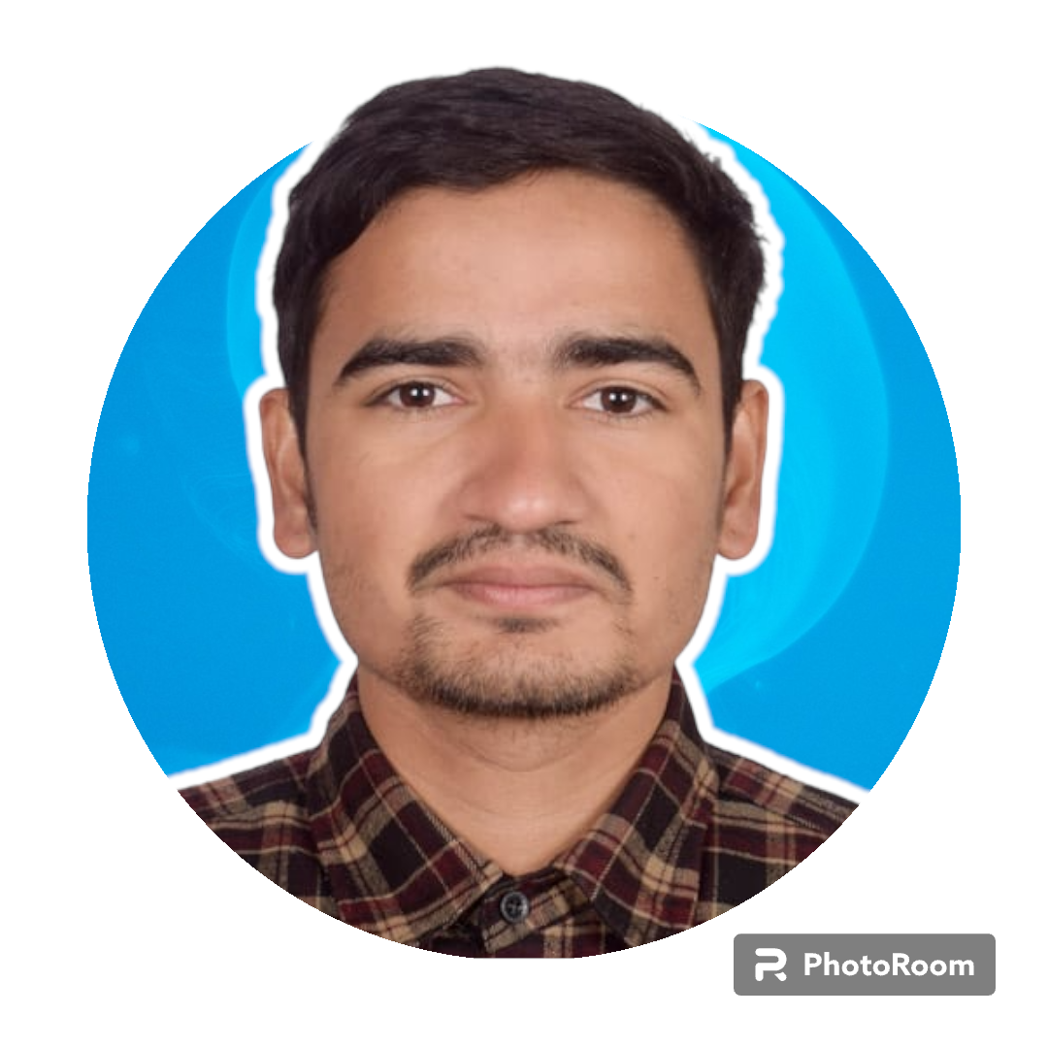
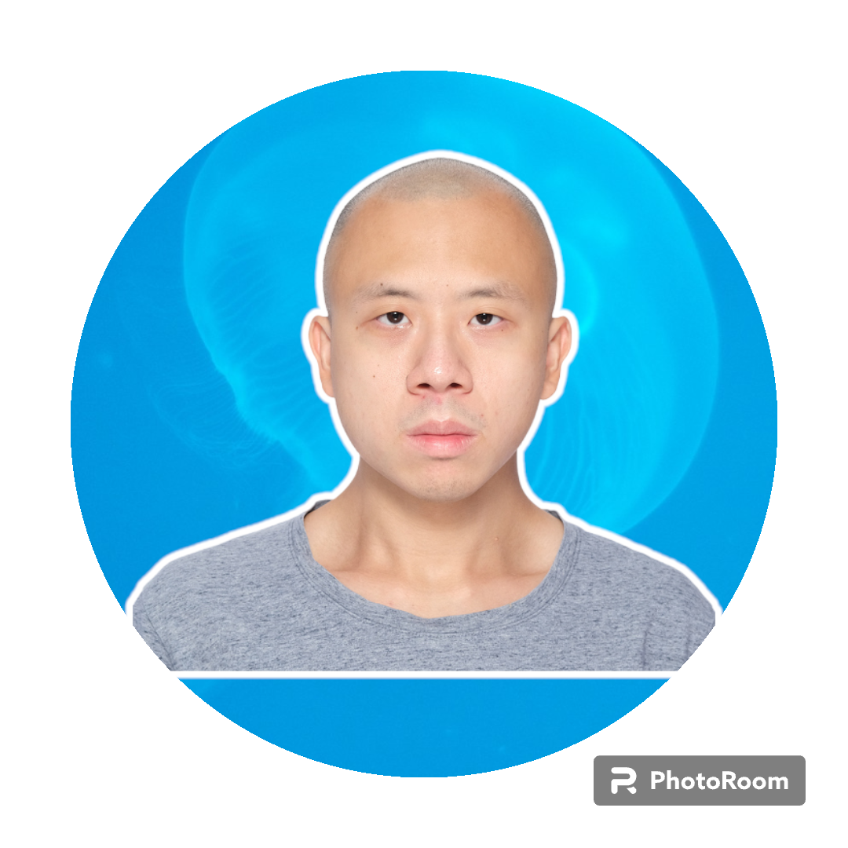
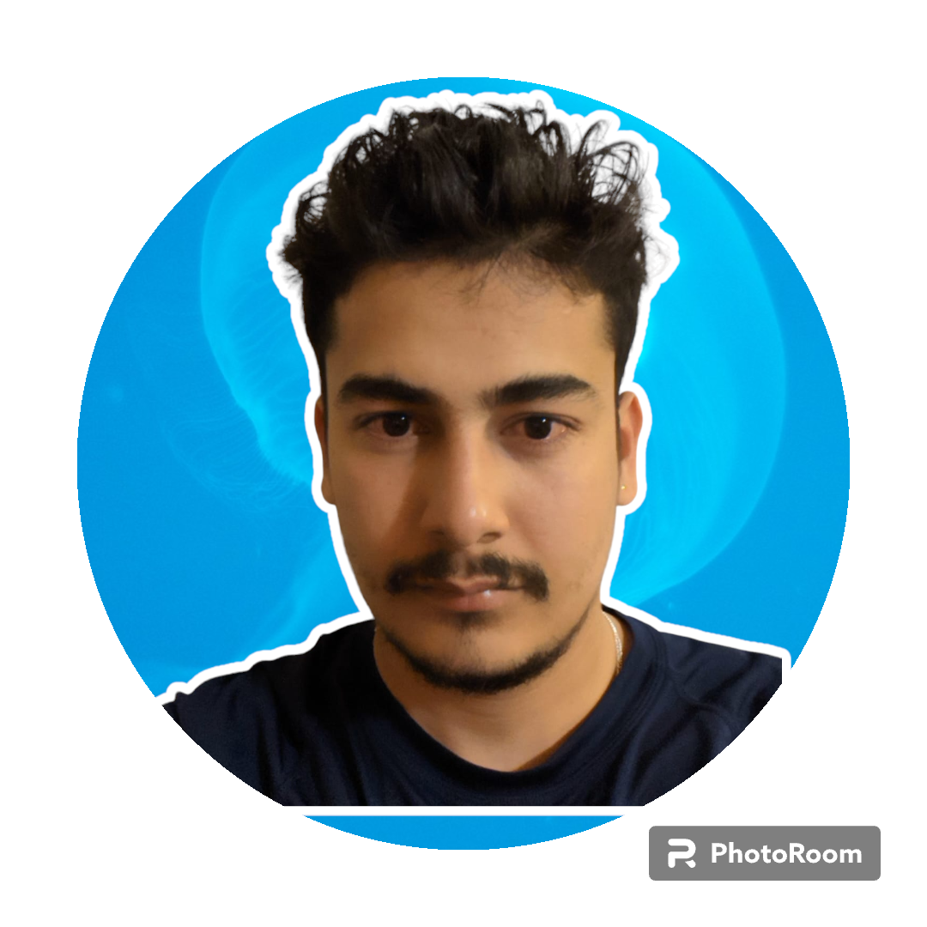
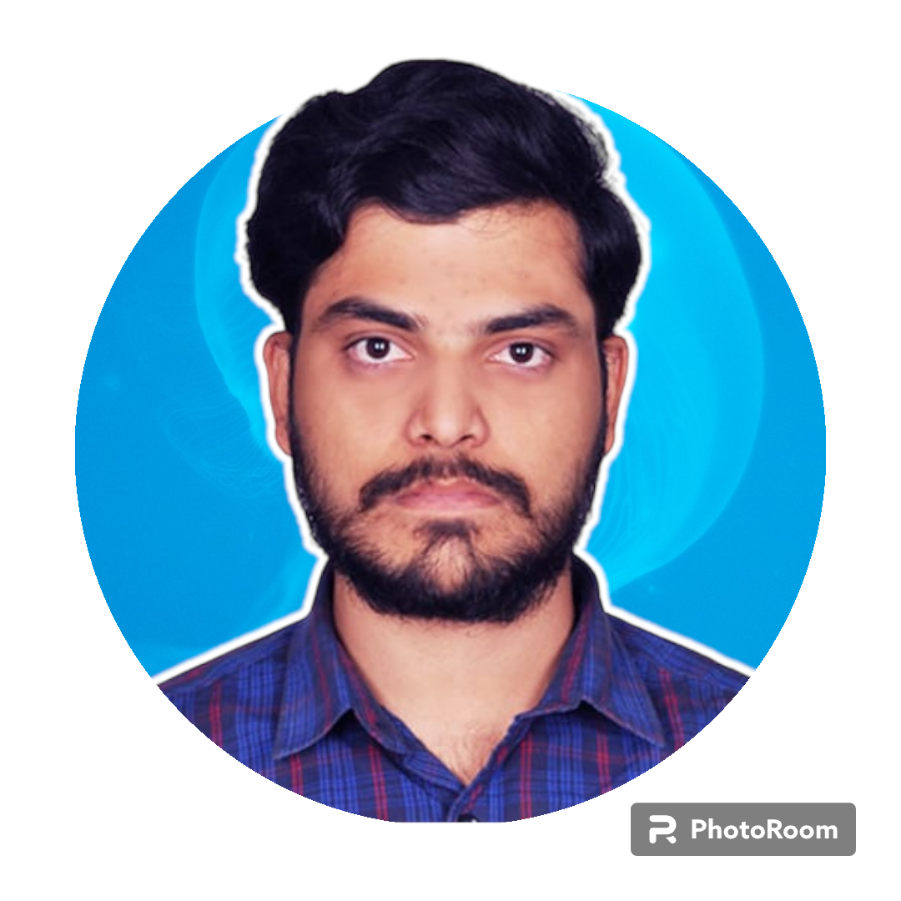










T
H
E
T
E
A
M
ILHAM SHEIKH
PROJECT MANAGER
KOSISOCHUKWU ABONE
LEAD APP DESIGNER
RAHUL GUPTA
GENERALIST PROGRAMMER
SURAJ SUBEDI
TECHNICAL ARTIST
JASON CHAN
WEB DESIGNER
SUBASH ARYAL
LEAD SOFTWARE ENGINEER
GAUTAM SAI GUNTUPALLI
DB PROGRAMMER/
SECURITY PROGRAMMER

Slide 3



Slide 4

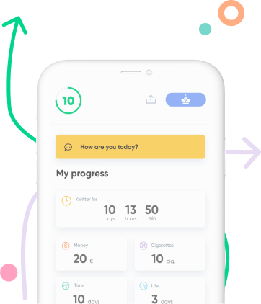
About the Application
Motive : To help people willing to quit smoking
How? With the help of an app that is more of a friend rather than a cop.
For whom? For people who are into smoking and are motivated to quit, but need help
Influence : Kwit
Target Platform : Android
Frameworks : Firebase, React

Slide 5

Our References
https://www.canada.ca/en/health-canada/campaigns/quit-smoking.html
https://youtu.be/ljW677R9eaE
https://youtu.be/yzIM9z-VUDE
This Photo by Unknown author is licensed under CC BY-SA.

Slide 6

Tools and Schedule
Project Management Tool : Jira
Team Meeting : Every Monday and Friday
Meeting Platform : Microsoft Teams

Slide 7


